Slide 1
Docker compose
ow

Slide 2
Multi-Container app
Docker Compose is used for running multiple containers as a single service.
Each of the containers here run in isolation but can interact with each other when required.
Docker Compose files are very easy to write in a scripting language called YAML, which is an XML-based language that stands for Yet Another Markup Language. Another great thing about Docker Compose is that users can activate all the services (containers) using a single command

Slide 3
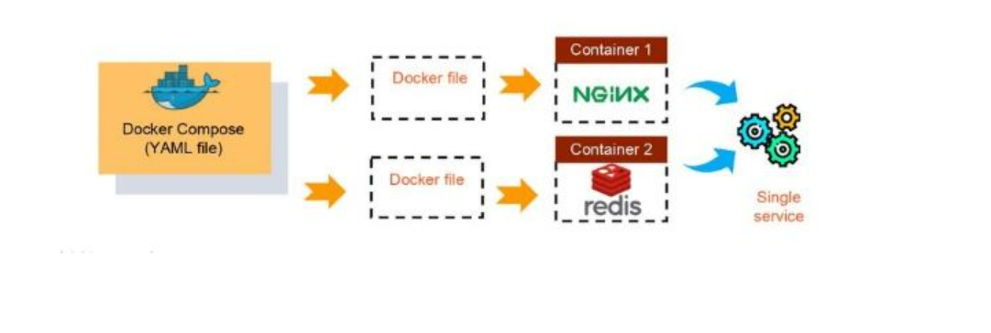
example
If you have an application that requires an NGINX server and Redis database, you can create a Docker Compose file that can run both the containers as a service without the need to start each one separately.

Slide 4
Benefits
Single host deployment - This means you can run everything on a single piece of hardware
Quick and easy configuration - Due to YAML scripts
High productivity - Docker Compose reduces the time it takes to perform tasks
Security - All the containers are isolated from each other, reducing the threat landscape

Slide 5
Docker compose basic commands
Start all services: Docker Compose up
Stop all services: Docker Compose down
Install Docker Compose using pip: pip install -U Docker-compose
Check the version of Docker Compose: Docker-compose-v
Run Docker Compose file: Docker-compose up -d
List the entire process: Docker ps
Scale a service - Docker Compose up -d -scale
Use YAML files to configure application services - Docker Compose.yml

Slide 6
Create a compose file
Create a file called docker-compose.yml at the root of the project.
We then proceed by defining and mentioning the version of the schema -
version: "<version number>"
To run as part of our application, we define the list of containers or services -
version: "<version number>"
services:
We then proceed to migrate a service one at a time to our already created Compose file.

Slide 7
..
services:
db:
container_name: db
image: mariadb:10-focal
restart: always
networks:
- backnet
volumes:
- db-data:/var/lib/mysql
- /run/secrets/db-password:/run/secrets/db-password:ro
- "8080:80"

Slide 8
Persistent Data StorageThe database data is stored persistently using the volume db-data:/var/lib/mysql, ensuring that data remains even if the container is restarted.
Secure Password ManagementThe root password is managed securely using Docker secrets (/run/secrets/db-password), preventing sensitive credentials from being exposed in the docker-compose.yml file.
Network IsolationThe database is connected to a specific network (backnet), ensuring that it is isolated from unwanted external access and can only communicate with allowed services.
Port Exposure for AccessibilityThe database exposes port 3306 for MySQL client connections and port 33060 for the MySQL X Protocol, allowing flexible database access.

Slide 9
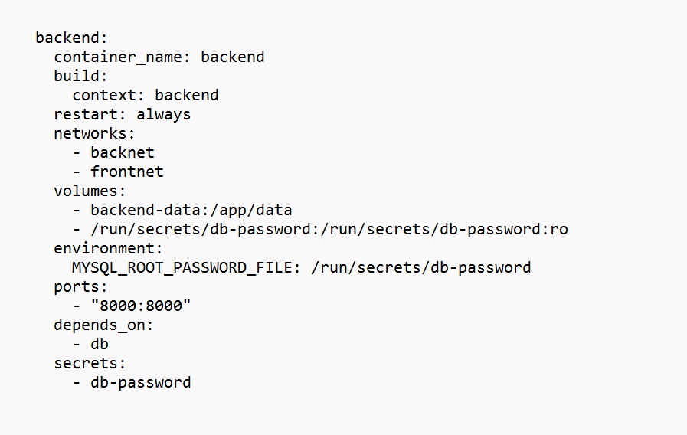
..

Slide 10
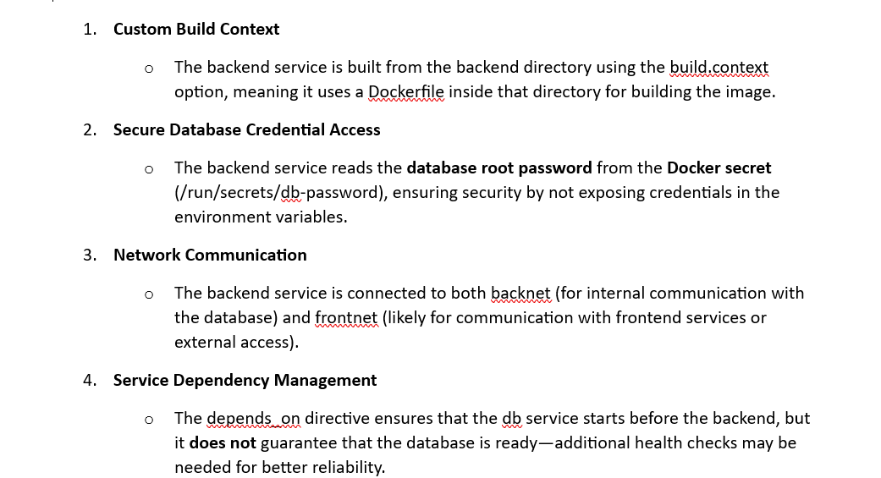
..

Slide 11
..
proxy:
container_name: proxy
build:
context: proxy
restart: always
networks:
- frontnet
ports:
- "81:80"
volumes:
- ./proxy/nginx.conf:/etc/nginx/nginx.conf:ro

Slide 12
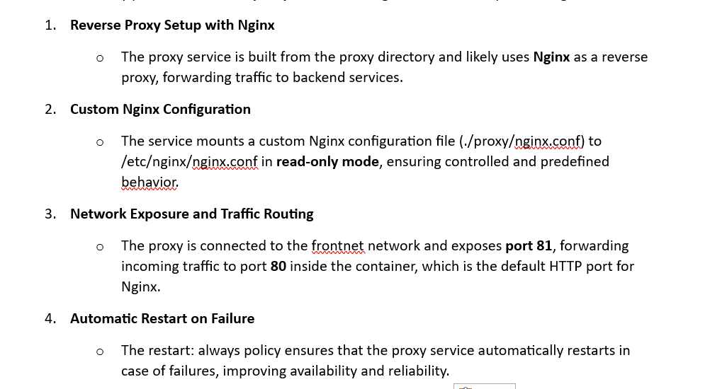
..

Slide 13
labs

Slide 14
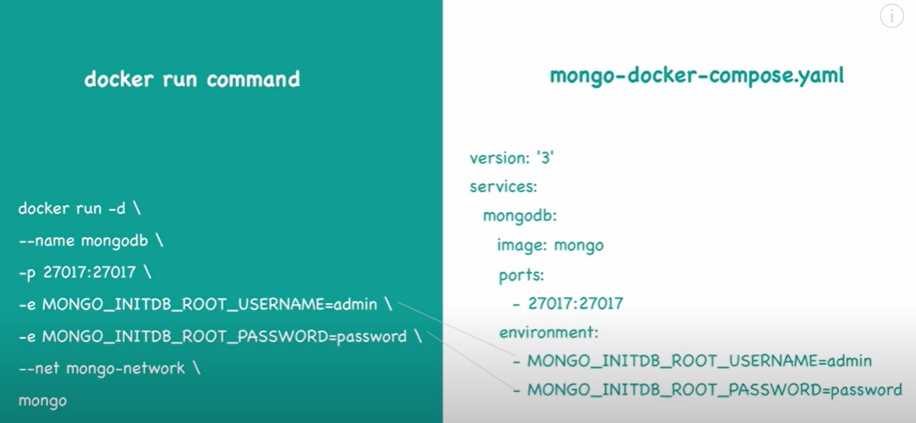

Slide 15
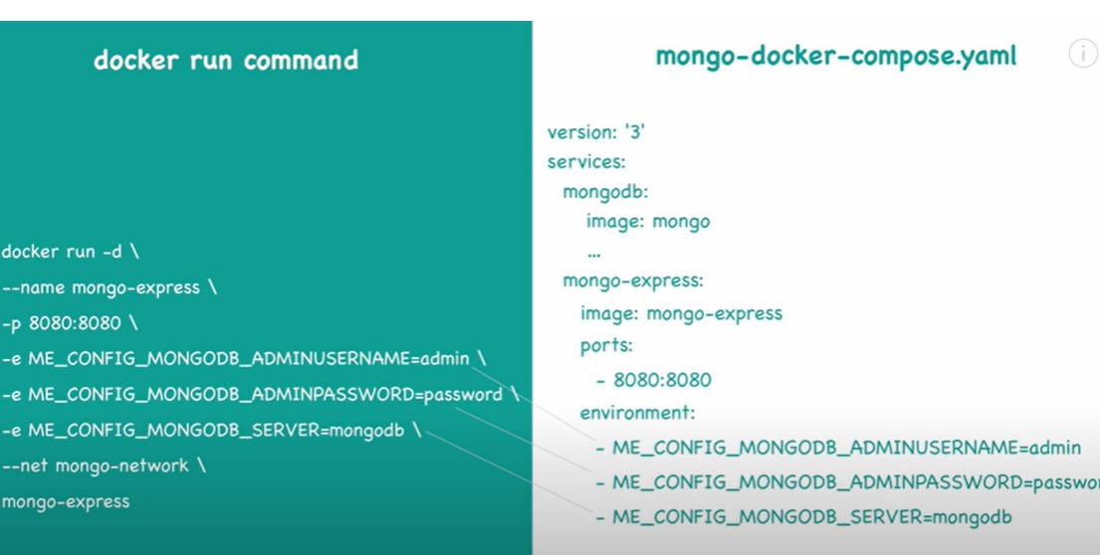

Slide 16
